Slide 1
Faisal Surgical & Medical Complex
A trusted Name in Medical & Health Care Services

Slide 2
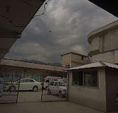
Faisal Surgical & Medical Complex
A Trusted Name in Medical & Health Care

Slide 3
Faisal Surgical & Medical Complex
The Only Trauma Centre
A entity serving its patients round the clock. Situated in the Heart of (Oghi) Agrawar & Tanawal
Providing health care services from the last twenty years.
An entity offering the largest of specialist doctors in diverse fields.
An Hospital equipped with modern facilities OT,E-Ray, Laboratory & Separate specialized Medical wards for Male & Female

Slide 4
Faisal Surgical & Medical Complex
We offer a wide range services starting First Aid to Complex medical care, from General Surgery to Gynae, from orthopedic to infant fertility

